Slide 1
SuPy Bowl Analysis
Created and Presented by:
Austin Rodriguez
John Leelike
Michael Cordes
Troy Prata

Slide 2
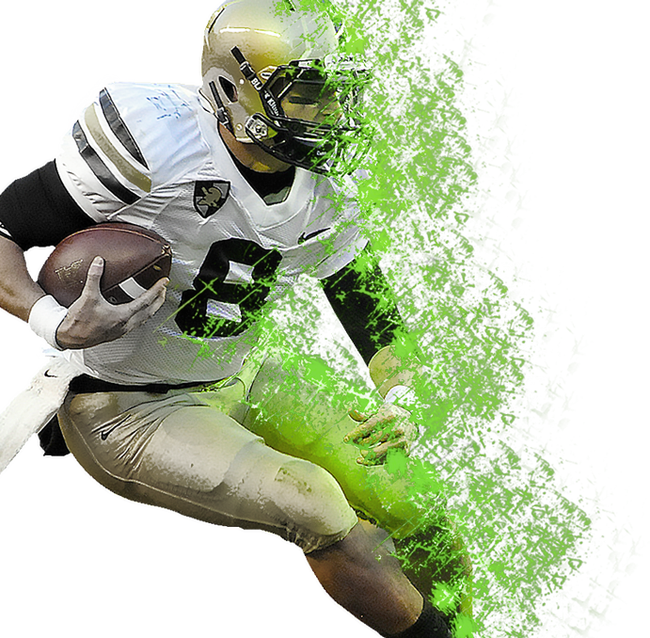
Agenda
01
Our Big Question!
We will share with you our big question and how our team theorized which betting strategy will produce the best returns.
02
Our Journey
We will the steps we took to figure out where we are getting our data, how we would get it and how we would clean, slice and analyze it.
03
The Big Game!
We will share our analysis results and reveal what strategy will have the best returns.
04
Code Review
Members from our team will walk you through important segments of our code.
05
Questions & Answers
This is your time to ask questions!

Slide 3
Which Betting Strategy Wins?
Betting Strategy Parameters
Each better bets a total of $100
Super Bowl favorites are defined as the team with the lowest odds pay
Odds retrieved from https://www.pro-football-reference.com/
The period of review is 1990 through 2021 season.
Strategy 1
Places one bet of $100 on the preseason favorite
$100 on preseason favorite
Strategy 2
Places a total of two bets. $50 on each of the top two preseason favorites
$50 on each of the top two preseason favorites
Strategy 3
Places a total of five bets. $20 on each of the top five preseason favorites.
$20 on each of the top five preseasons favorites
Notes:
Review strategies
Agenda Topic 1 – discuss strategies; ask audience to respond to poll: https://www.surveymonkey.com/r/PS6Z2MP

Slide 4
Team Hypothesis of Betting Strategy
The team collectively hypothesized each strategy
Strategy 1 is the favorite of the three strategies
What strategy do you believe is the winning strategy?
Team Hypothesis
Notes:
We created a survey to gauge how everyone on our team thought.
Agenda Topic 1 – discuss strategies; ask audience to respond to poll: https://www.surveymonkey.com/r/PS6Z2MP
Share poll results using dashboard: https://www.surveymonkey.com/stories/SM-73G3W7KW/edit/

Slide 5

Our Team Journey
How will we find and get the data we need?
???’S
How will we review and connect the data we found?
ENTER
How will we analyze our data?
What betting strategy has the best return?
Notes:
Now that we our big question, we needed to figure out how we will get our answers. Our journey

Slide 6
Data Data Data!
12
What data do we need?
How would we get the needed data?
How do we clean up our data?
What do we do with the data now?
Are our results correct?
Preseason Super Bowl odds
Super Bowl outcomes
Super Bowl locations
Web sites
APIs
Data populated .csv files
Identify common data points across data
Consolidate data into usable data frame(s)
Drop data that did not match time period
Define functions to match strategies to odds and winners
Calculate cumulative returns sums
Super Bowl locations
Does the result make sense?
Code review
Healthy team debate
Notes:
What data do we need
Our big question provided the foundation for what data was needed. This was the easy part. We knew we needed preseason odds, the game outcomes and for additional analysis, game locations.
How would we get the needed data
Once agreed on the data we wanted, the next question was, where can we find this?
We found https://www.pro-football-reference.com/ provided historical preseason odds. The problem is the website presented the data by year on separate pages. How could we easily and effectively download the data without manually doing it? We created an empty data frame to store our data. Next, we defined the start year and end year. Finally, we created a for look that would navigate to each year’s page, read the data, and append it to the data frame. We will show you this in detail during our code review.
We used an API from sportsdata.io to create a csv of every Super Bowl’s geo data (latitude and longitude)
Finally, we found a csv on Kaggle.com that provided additional details about all team stadiums.
How do we clean up our data?
We had so much data that it needed to be slice, dice, splice and clean to prepare for our analysis. An example of some of our clean up, we created strategy data frames that will provide the top 1, 2 , or 5 teams based on the strategy.
What do we do with the data now?
Now that our data was prepared, we were ready to conduct analysis of the strategies. We take a deep dive into the code when we review our code, but I’ll provide a sneak peak. We defined three separate functions with multiple elif statements to populate a data frame. One function defines if the Super Bowl winner is in the strategy, the next function calculates the return and the next function defines if the best is lost the amount of the original bet is removed form the .cumsum calculation.
Are our results correct?
We were satisfied once we were able to get results after all of our data collection, preparation, and analysis. However, once we started plotting, questions started to arise about the accuracy of our results. We had healthy group debates about the accuracy of the first round of results. We walked through the code as a team and recalculated results. After some review it was identified that there was a miscalculation that resulted in inflating of one strategy. We corrected the code and reran the code to get accurate results.
The next few slides will show how we visualized our data analysis.

Slide 7
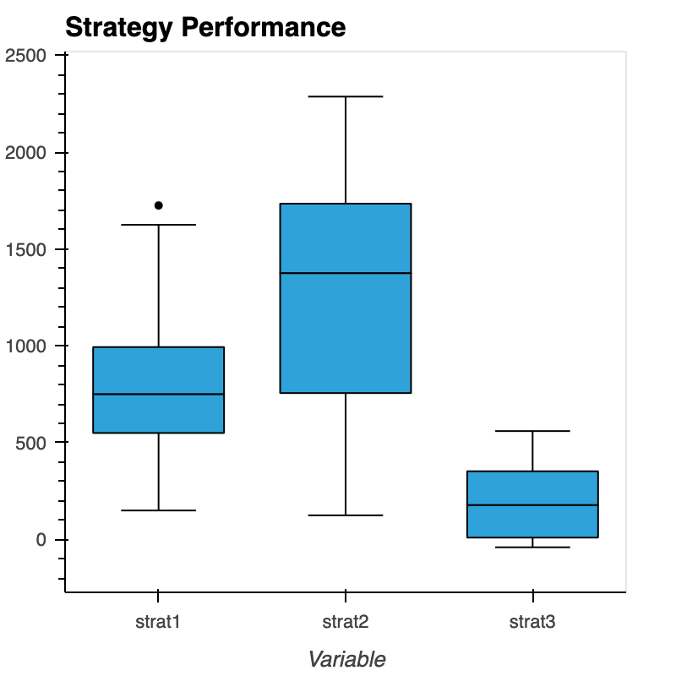
Box Plot
Content B
Get a modern PowerPoint Presentation that is beautifully designed.
We used this plot to identify which city had the most Super Bowls played during our period of review.
The answer is New Orleans followed by Miami.
Notes:
This box plot was used to visualize the min, median max as well as any outliers. As you can see, strategy 2 has much large spread between the minimum and maximum returns while strategy 3 has a pretty tight grouping of min and max.

Slide 8
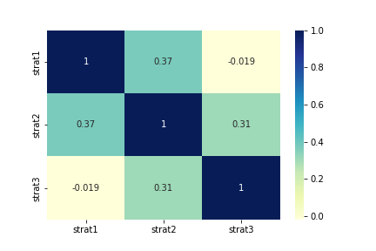
Correlation Heat Map Plot
Content B
Get a modern PowerPoint Presentation that is beautifully designed.
We used this plot to identify which city had the most Super Bowls played during our period of review.
The answer is New Orleans followed by Miami.
Notes:
This heat map was used to analyze if there is a correlation between any of the returns for the strategy returns. While the chart shows Strategy 1 and Strategy 2 are positive correlation and strategy 3 has a negative correlation, I believe the heat map would have more value with more strategies to analyze.

Slide 9
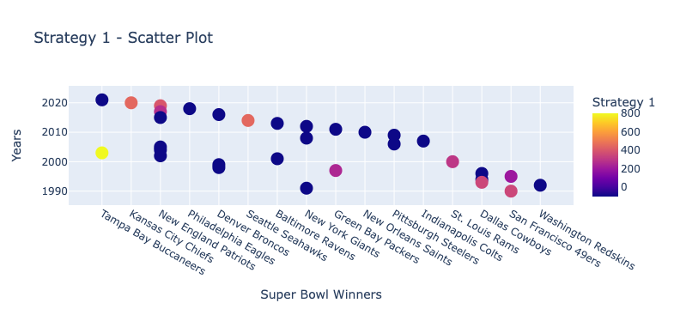
Scatter Plot – Strategy 1
Content B
Get a modern PowerPoint Presentation that is beautifully designed.
We used this plot to identify which city had the most Super Bowls played during our period of review.
The answer is New Orleans followed by Miami.
Notes:
This plot visualizes the relationship between years and teams that won. We also wanted to incorporate the return on the bet the winning team provided. In this strategy, the greatest return came from the 2002 (played in 2003) Tampa Bay Buccaneers (Go Bucs!).

Slide 10
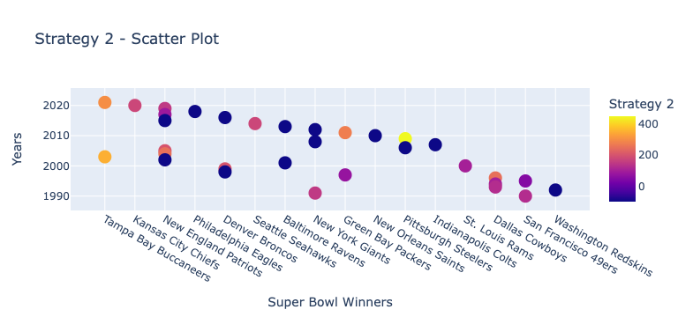
Scatter Plot – Strategy 2
Content B
Get a modern PowerPoint Presentation that is beautifully designed.
We used this plot to identify which city had the most Super Bowls played during our period of review.
The answer is New Orleans followed by Miami.
Notes:
This plot visualizes the relationship between years and teams that won. We also wanted to incorporate the return on the bet the winning team provided. In this strategy, the greatest return came from the 2008 (played in 2009) Pittsburg Steelers.

Slide 11
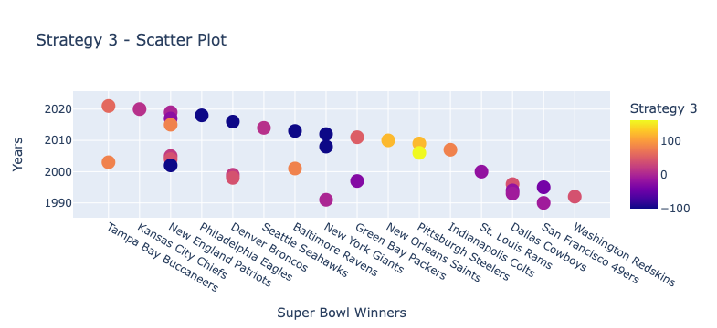
Scatter Plot – Strategy 3
Content B
Get a modern PowerPoint Presentation that is beautifully designed.
We used this plot to identify which city had the most Super Bowls played during our period of review.
The answer is New Orleans followed by Miami.
Notes:
This plot visualizes the relationship between years and teams that won. We also wanted to incorporate the return on the bet the winning team provided. In this strategy, the greatest return came from the 2008 (played in 2009) Pittsburg Steelers.

Slide 12
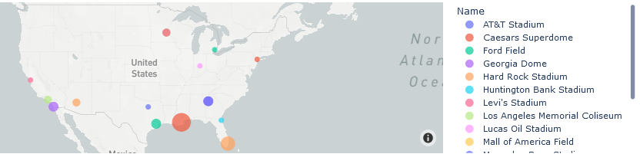
Geo Plots
Content B
Get a modern PowerPoint Presentation that is beautifully designed.
We used this plot to identify which city had the most Super Bowls played during our period of review.
The answer is New Orleans followed by Miami.
Notes:
One question that popped in our heads throughout our analysis was, what city/stadium hosted the
We used an API to access the geolocation details for each stadium to create the csv used in our map plot which also uses mapbox API to generate the map. This process produces a more astatically pleasing result than a simple pivot table or data table.

Slide 13

Betting Strategies Results
Strategy 2 is the winner!
Strategy 2 yielded $2,287.50
$295
$1,625
$2,287.50
#3
#1
#2
Strategy 3
Strategy 1
Strategy 2
We recommend avoiding this strategy. If one bet wins, the return does may not outweigh the lost funds on the losing bets.
This strategy provides larger payouts than strategy 3 but does not outperform strategy 2.
Diversifying the risk by splitting the $100 across the top two favorites has the best return.
Notes:
Review the slide and recommendations.

Slide 14
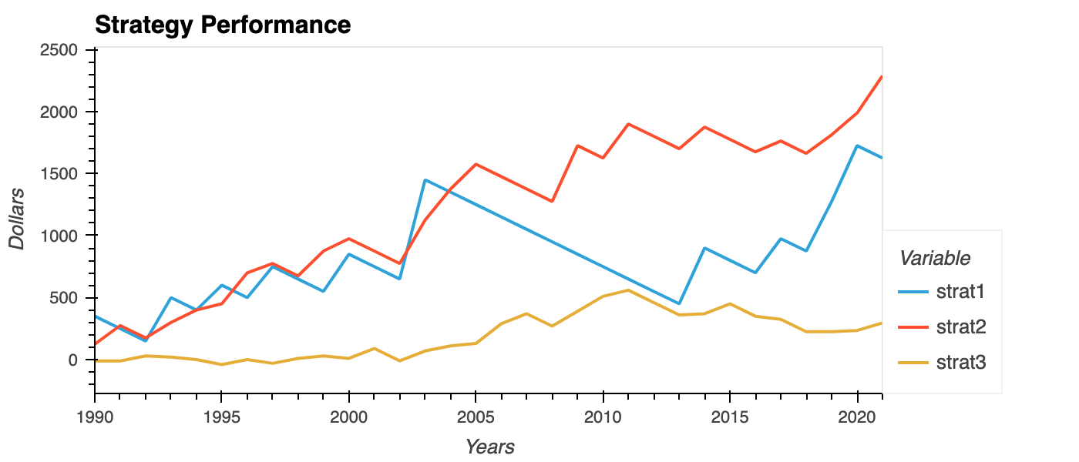
Histogram Plot
Content B
Get a modern PowerPoint Presentation that is beautifully designed.
We used this plot to identify which city had the most Super Bowls played during our period of review.
The answer is New Orleans followed by Miami.
Notes:
This histogram was used to visualize the returns throughout the strategy. As you can see, strategy 1 and strategy 2 take turns leading for the first 15ish years, however, strategy 1 nose dives the next 10 years and is almost outperformed by strategy 3. The strategy does rebound around 2013 but cannot catch up to strategy 2.
I believe odds makers either got tired of losing on the favorite or became really bad at their jobs. I’ll let you be the judge….
Let’s dive into our code!

Slide 15
Questions?
Thank you!
Notes:
Agenda Topic 5 – q&a

